Slide 1

APPLICATION OF MACHINE LEARNING FOR ENSURING WATER QUALITY IN AQUACULTURE PONDS
SRM INSTITUTE OF SCIENCE AND TECHNOLOGY
FACULTY OF ENGINEERING AND TECHNOLOGY
DEPARTMENT OF DATA SCIENCE AND BUSINESS SYSTEMS
18CSP109L- MAJOR PROJECT
Paidipati Lakshman Sai (RA2011027010202)
Paidipati Charan Ram (RA2011027010186)
Gangireddy Sai Preetham (RA2011027010180)
Kakuru Jaya Praveen (RA2011027010198)
Guide name: Dr. SV. Shri Bharathi
Designation: Assistant Professor

Slide 2
Table of contents
Abstract
Introduction
Literature Review
Challenges and Limitations
Objectives
Innovation idea of the project
Scope and Application
Architecture
Proposed Modules and their Algorithm Description
Uml Diagram
Implementation
Result Analysis
Research Paper

Slide 3
Abstract
Aquaculture plays a pivotal role in meeting the growing global demand for seafood. However, ensuring optimal water quality within aquaculture ponds is a pressing challenge. This project proposes a paradigm shift by integrating machine learning to enhance water quality assurance. The system leverages real-time monitoring, predictive analytics, and adaptable algorithms, contributing to sustainability and responsible aquaculture practices.

Slide 4
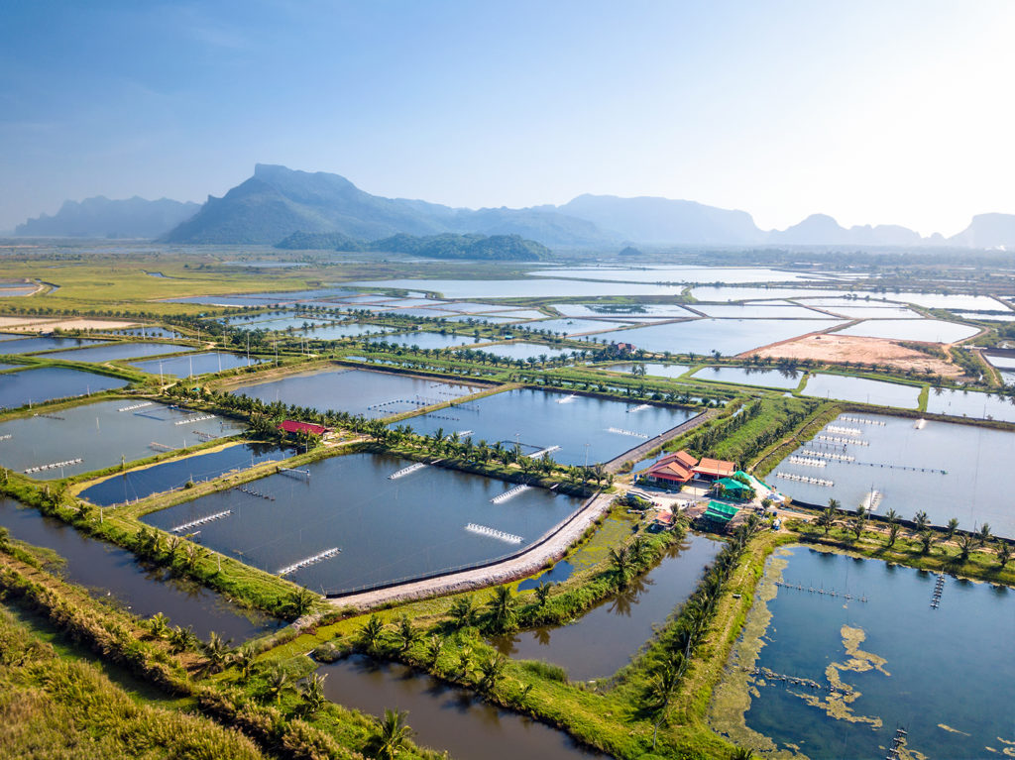
Introduction
Aquaculture, a key contributor to global seafood production, faces challenges in maintaining optimal water quality within ponds. Fluctuations in temperature, pH, and dissolved oxygen can impact aquatic organisms. Traditional monitoring methods are often labor-intensive and lack real-time capabilities, necessitating a technological solution. This project addresses the gap in water quality assurance by introducing a machine learning-based system.

Slide 5
Literature Review
Water quality assurance in aquaculture ponds using Machine Learning and IoT techniques
AUTHOR: Ricardo Quintero; Jaqueline Parra; Francisco Félix
The following work proposes a framework for monitoring and forecasting water quality parameters (temperature and dissolved oxygen) at different scales of the aquaculture industry, either for post larval laboratories, in aquaculture farms or at the time of transporting the product to an aquaculture farm. The prototype system was implemented for the transportation of the aquaculture product and consists of a system of dissolved oxygen and temperature sensors that send the data from the sensors via Bluetooth Low Energy to a mobile application where they are processed and sent via internet to a web application so that users can receive alerts and visualize the monitoring data and the forecast model that was developed using a Long short-term memory (LSTM) neural network so that users can take measures in time to avoid losses in aquaculture production

Slide 6
Machine learning approach to investigate the influence of water quality on aquatic livestock in freshwater ponds
AUTHOR: Mashud Rana , Ashfaqur Rahman , Joel Dabrowski , Stuart Arnold, John McCulloch, Bruno Pais .
Water quality (WQ) is a key factor that affects harvest outcome from freshwater ponds. Irregular or aperiodic variations of different WQ variables can influence the growth, survival, and yield of aquatic livestock in the ponds. In this research, WQ and harvest data collected from an Australian prawn farm over a whole grow-out season is used to investigate how the variations of WQ influence the harvest outcome of prawns from the ponds. We present a set of approaches based on machine learning to: (i) understand the effect of five WQ variables in differentiating high and low performing ponds (in terms for harvest performance); and (ii) identify how the variations in these WQ variables over the grow-out season contributed to final harvest outcome (growth and yield). To develop the ponds classification approach, we apply eight different machine learning classifiers: neural networks, support vector machine, k-nearest neighbours, logistic regression, gaussian naïve bayes, decision tree, random forest, and AdaBoost. To identify the driving factors (in terms of variations of WQ) that affect growth and yield of aquatic livestock in ponds, we apply three feature selection methods: mutual information, correlation-based feature selection, and Relief.

Slide 7
Application of machine learning in intelligent fish aquaculture
AUTHOR: Shili Zhao a b, Song Zhang , Jincun Liu , He Wang , Jia Zhu , Daoliang Li, Ran Zhao
Among the background of developments in automation and intelligence, machine learning technology has been extensively applied in aquaculture in recent years, providing a new opportunity for the realization of digital fishery farming. In the present paper, the machine learning algorithms and techniques adopted in intelligent fish aquaculture in the past five years are expounded, and the application of machine learning in aquaculture is explored in detail, including the information evaluation of fish biomass, the identification and classification of fish, behavioral analysis and prediction of water quality parameters. Further, the application of machine learning algorithms in aquaculture is outlined, and the results are analyzed. Finally, several current problems in aquaculture are highlighted, and the development trend is considered.

Slide 8
Water quality assurance in aquaculture ponds using Machine Learning .
AUTHOR: Ricardo Quintero; Jaqueline Parra; Francisco Félix
The following work proposes a framework for monitoring and forecasting water quality parameters (temperature and dissolved oxygen) at different scales of the aquaculture industry, either for post larval laboratories, in aquaculture farms or at the time of transporting the product to an aquaculture farm. The prototype system was implemented for the transportation of the aquaculture product and consists of a system of dissolved oxygen and temperature sensors that send the data from the sensors via Bluetooth Low Energy to a mobile application where they are processed and sent via internet to a web application so that users can receive alerts and visualize the monitoring data and the forecast model that was developed using a Long short-term memory (LSTM) neural network so that users can take measures in time to avoid losses in aquaculture production.

Slide 9
Challenges and Limitations
Challenges:
Integrating heterogeneous data sources.
Balancing complexity and interpretability in predictive models.
Addressing imbalanced datasets and optimizing model robustness.
Ethical considerations regarding data privacy.
Limitations:
Potential inaccuracies in data collection due to sensor malfunctions.
Risks associated with system failures leading to data loss or misinterpretation.

Slide 10
Objectives
The research objective is to pioneer a comprehensive water quality assurance system for aquaculture ponds through the integration of machine learning.
Specific objectives include the development of advanced predictive models, overcoming data integration complexities, addressing ethical considerations, and optimizing scalability and cost-effectiveness.

Slide 11
Innovation Idea of the Project
The project's innovation lies in the fusion of machine learning and aquaculture practices. Real-time monitoring, accurate predictive models, and adaptable algorithms form the backbone of the system.
The user-friendly interface ensures accessibility, while ethical data handling protocols uphold privacy standards.
The continuous improvement mechanism guarantees the system evolves with industry needs, contributing to efficient, sustainable, and responsible aquaculture management.

Slide 12
Scope and Application
The scope of the project extends to aquaculture operations globally.
The system's adaptability ensures its applicability across diverse pond types and environments.
The technology is designed to benefit both large-scale and smaller facilities, contributing to the sustainable enhancement of aquaculture practices and the industry at large.

Slide 13
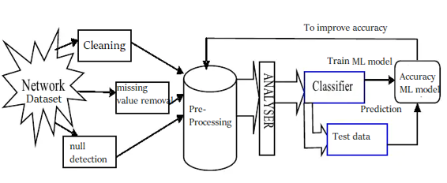
Architecture

Slide 14
Proposed Modules
Data Collection
Data Pre-processing
Feature Extraction
Machine Learning Algorithms
Model Training
Validation and Testing
Real-time Integration

Slide 15
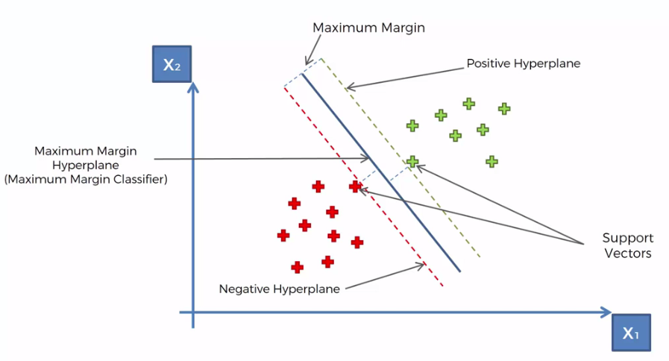
Algorithm Description
Support Vector Machine (SVM) is a powerful supervised learning algorithm used for both classification and regression tasks. The primary goal of SVM is to create a hyperplane that best separates different classes in the feature space. This hyperplane is positioned to maximize the margin between the classes, with support vectors—data points close to the decision boundary—playing a crucial role in defining this optimal separation.

Slide 16
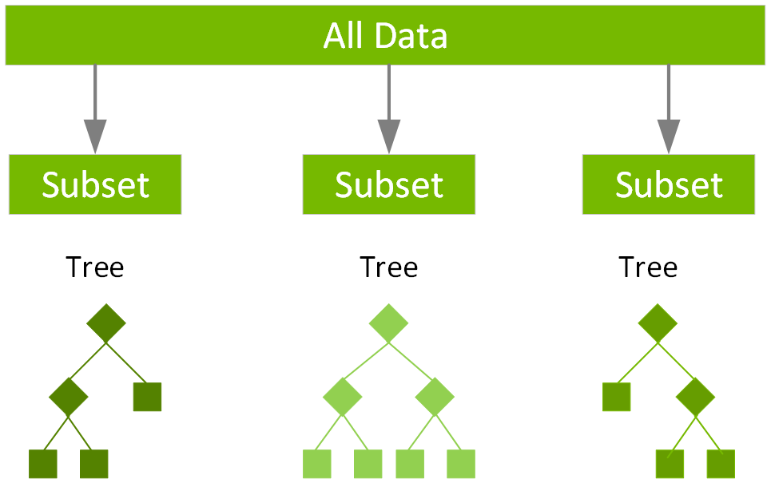
XG Boost (Extreme Gradient Boosting) is a scalable and efficient machine learning algorithm based on decision trees. It falls under the category of ensemble learning, where multiple weak learners (trees) are combined to create a robust model. XG Boost has gained popularity for its speed, scalability, and accuracy in a variety of machine learning tasks.

Slide 17
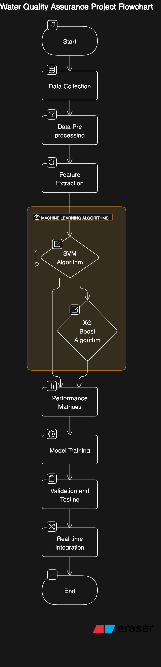
UML Diagram (Flow Chart)

Slide 18
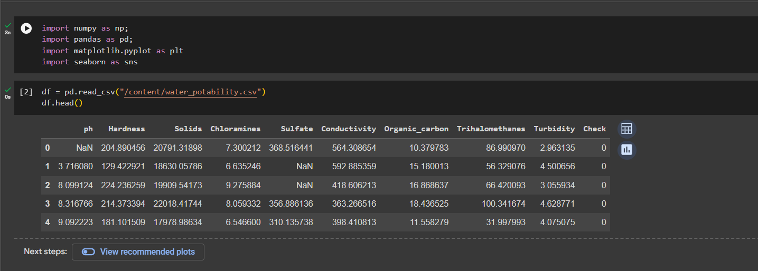
Implementation

Slide 19
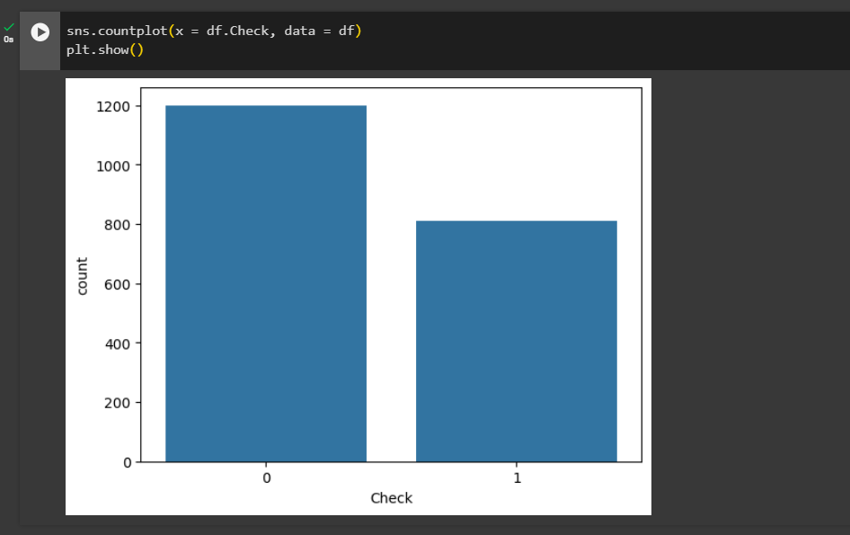

Slide 20
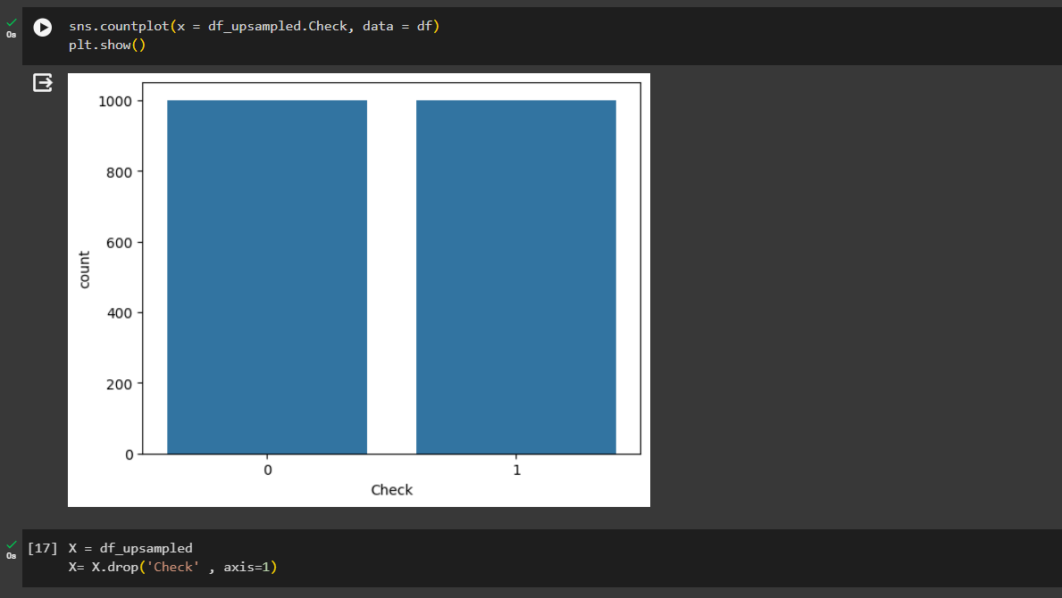

Slide 21
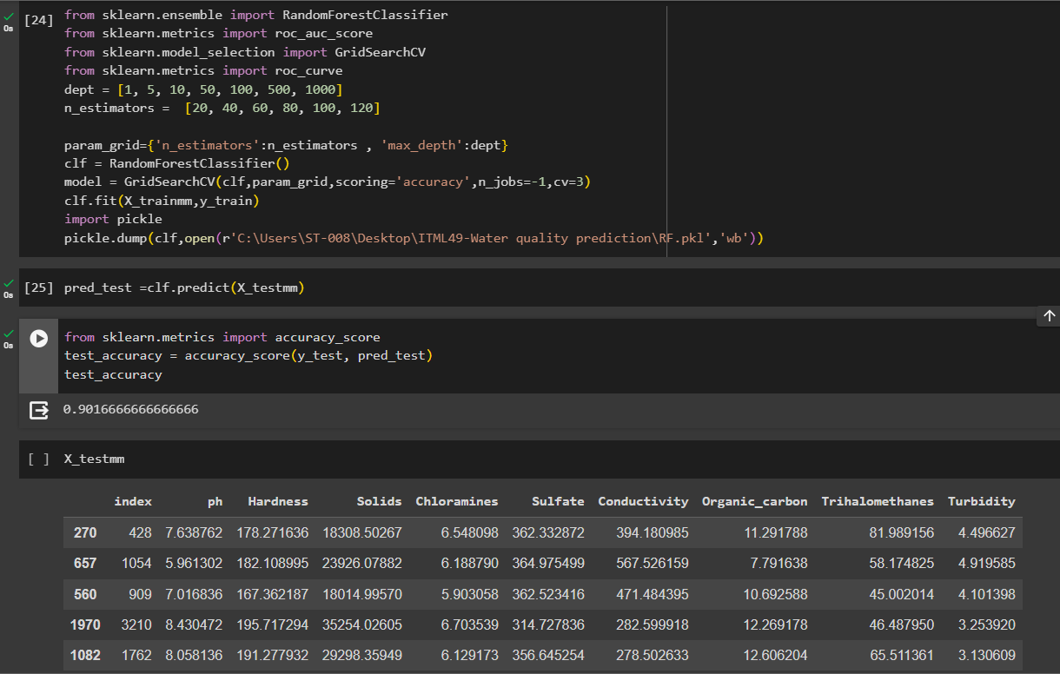

Slide 22
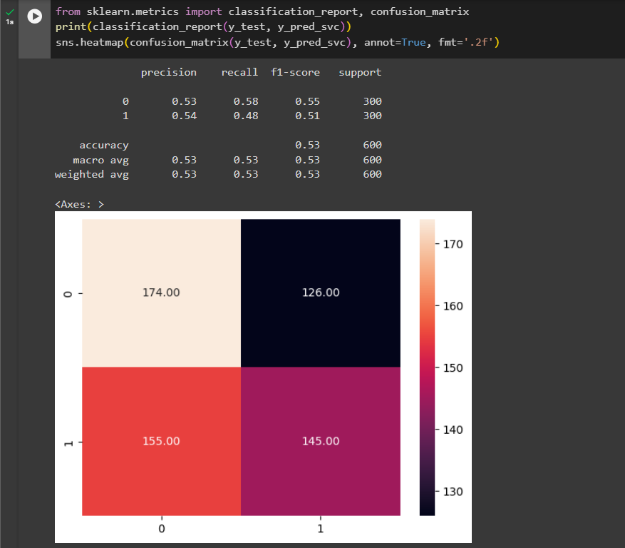

Slide 23
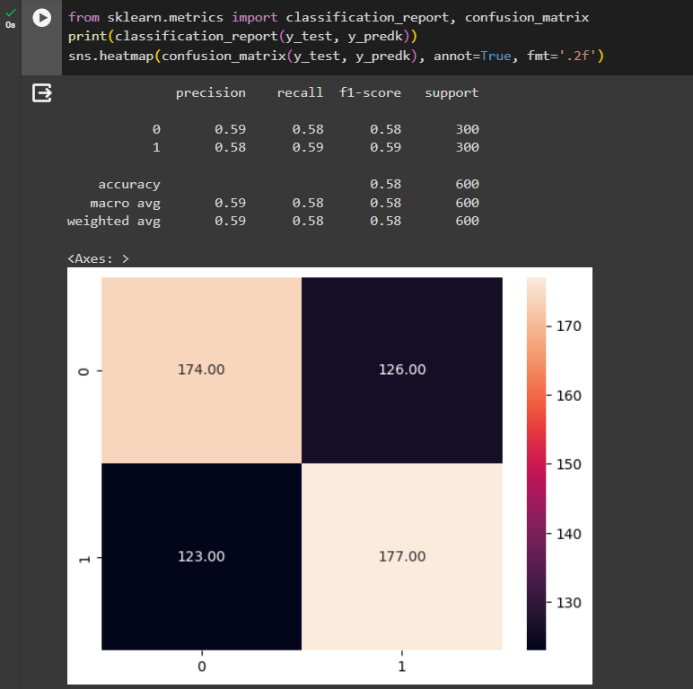

Slide 24
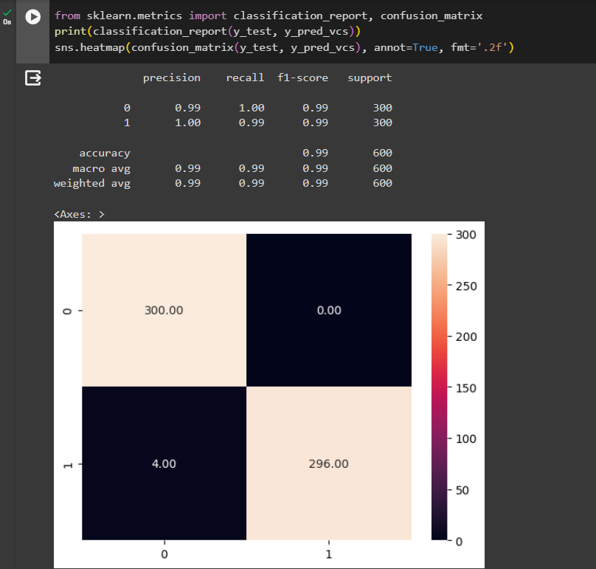

Slide 25
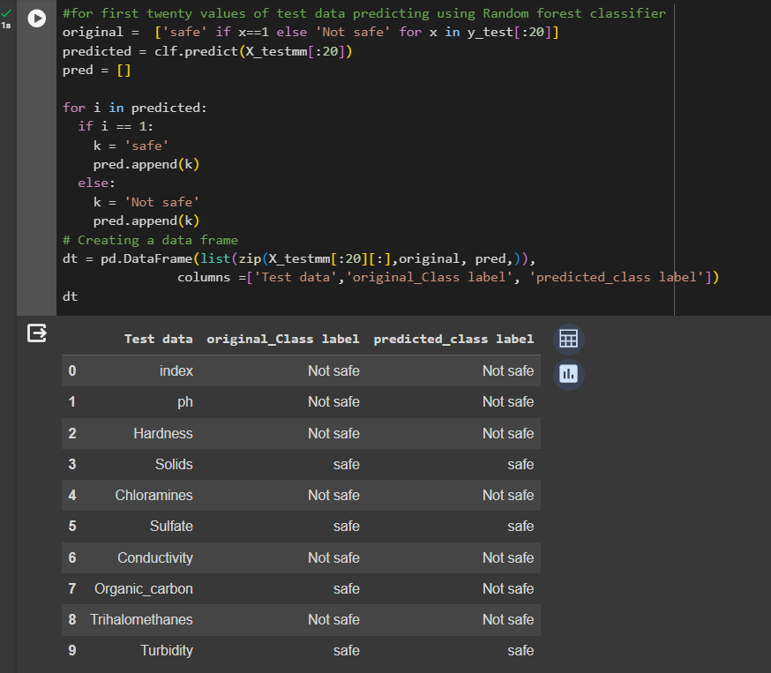

Slide 26
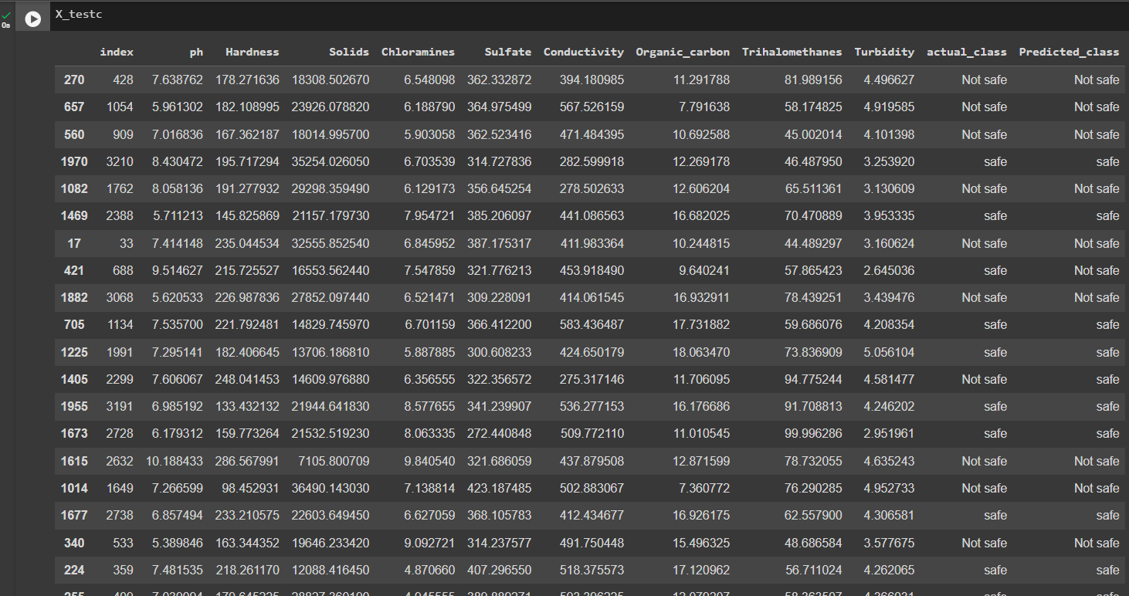

Slide 27
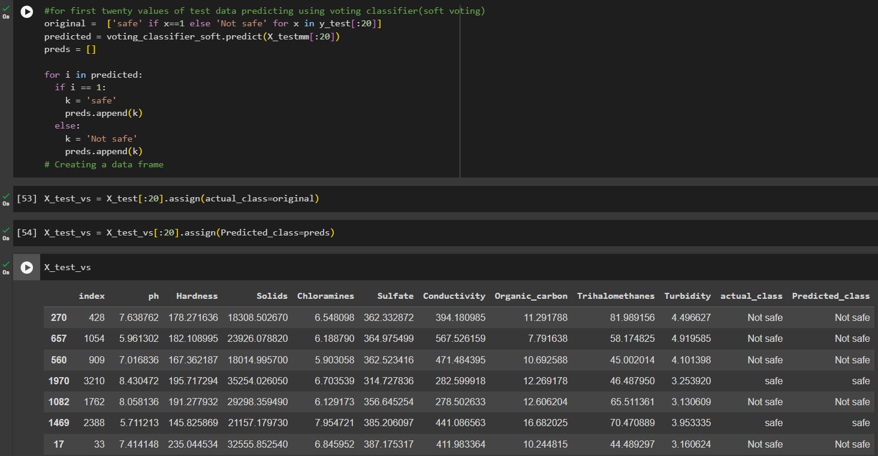

Slide 28
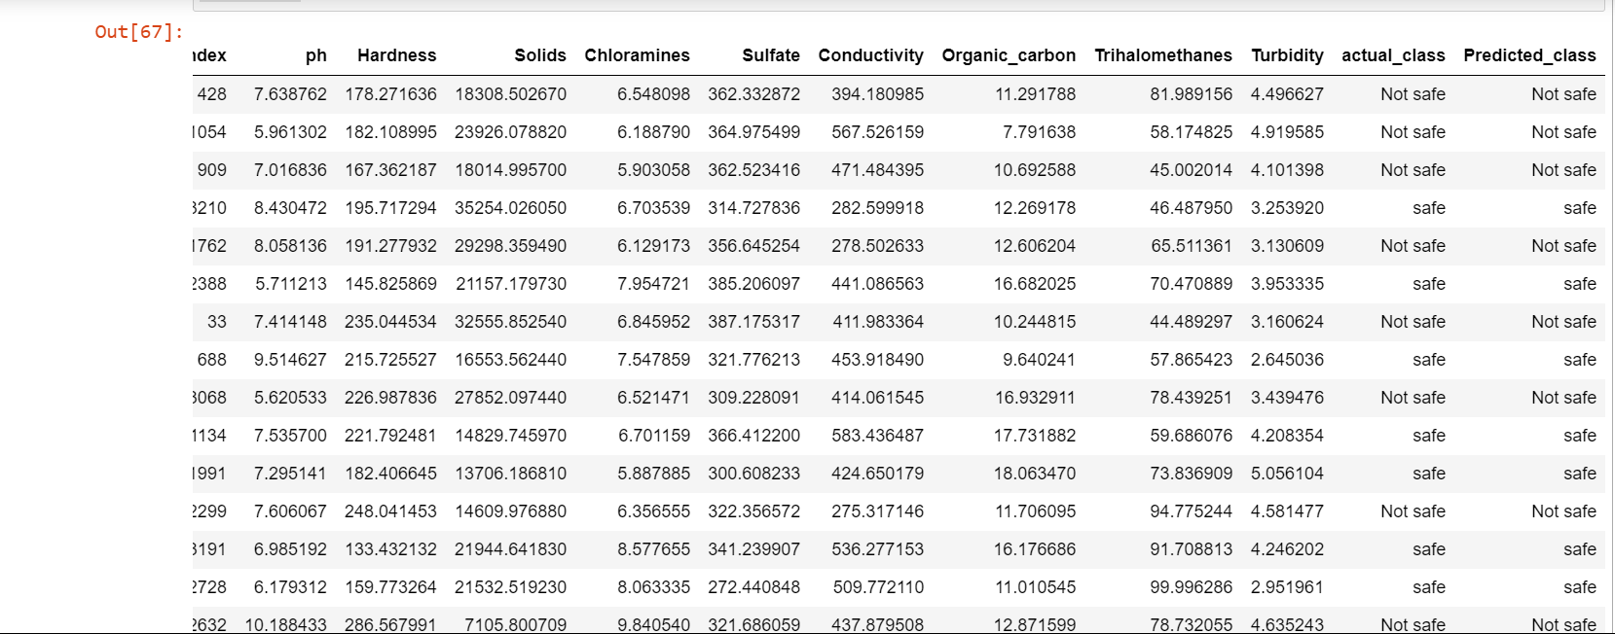
Result Analysis

Slide 29
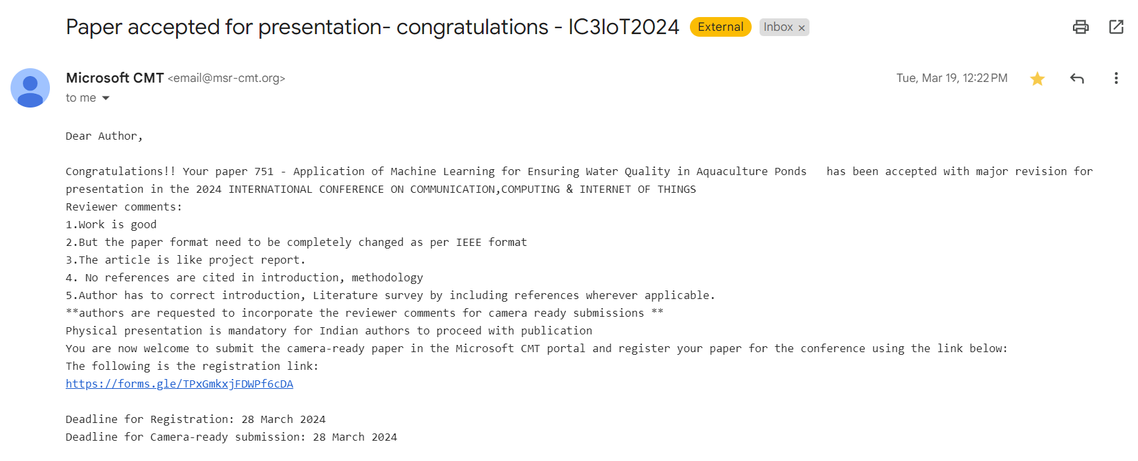
Research Paper

Slide 30
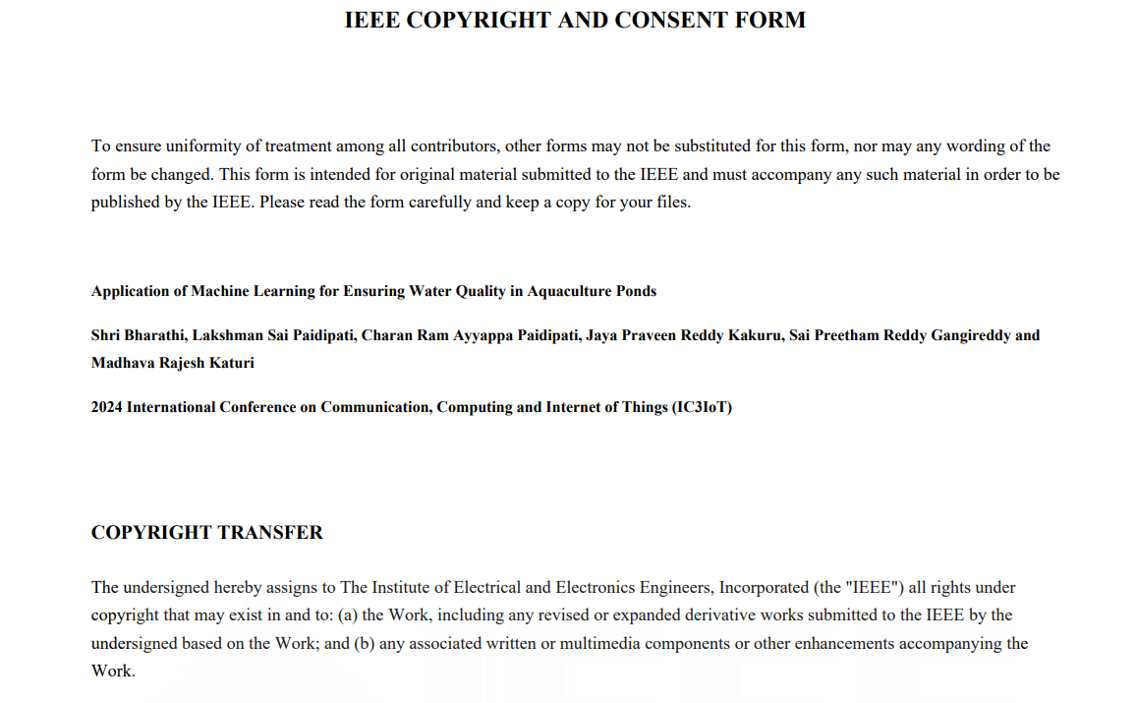

Slide 31
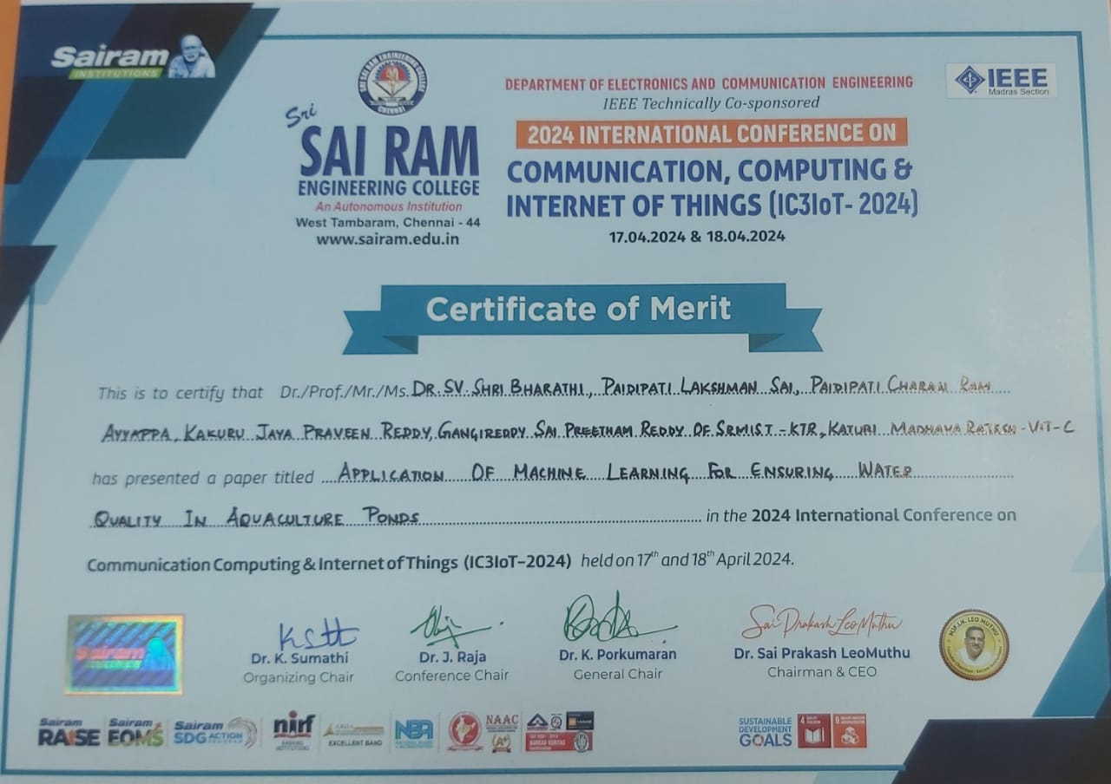

Slide 32
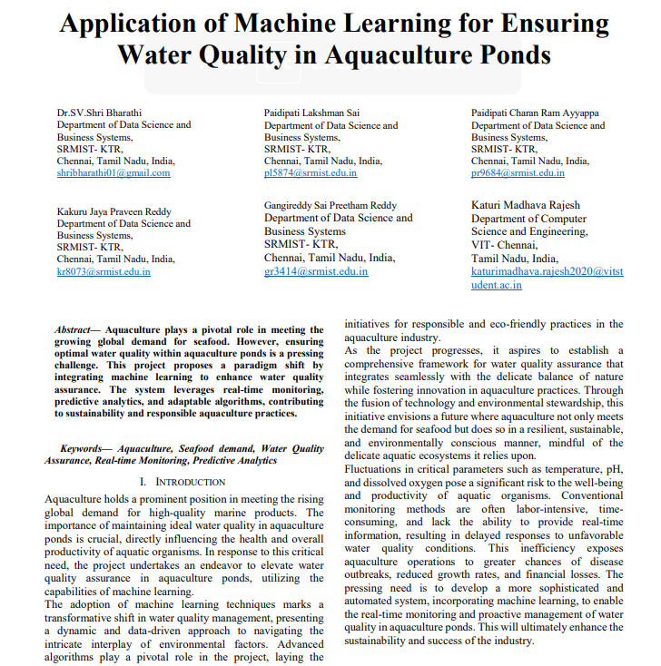

Slide 33
Thanks

